Slide 1
Algorithm Analysis and Design Divide and Conquer strategy (Convex Hull Problem)
Lecture -17

Slide 2
Overview
Learn the implementation techniques of “divide and conquer” in the context of the Convex Hull Problem with analysis.

Slide 3
Convex Hull
Given a set of pins on a pinboard, and a rubber band around them .
How does the rubber band look when it snaps tight? Just imagine.

Slide 4

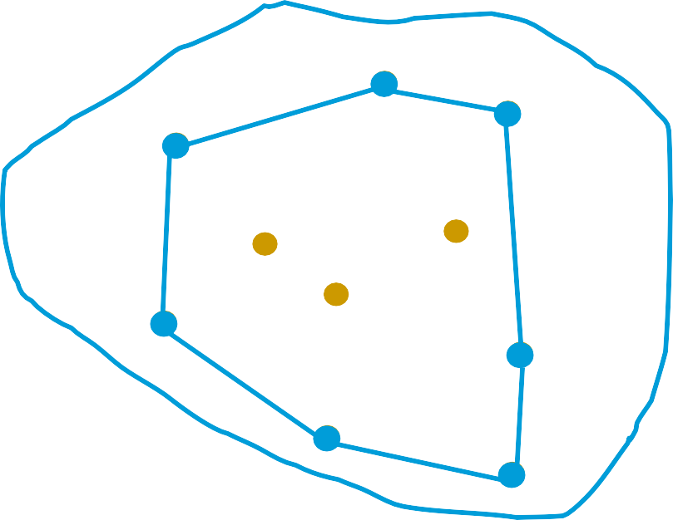
Convex Hull
Given a set of pins on a pinboard, and a rubber band around them .
How does the rubber band look when it snaps tight? Just imagine.
We represent the convex hull as the sequence of points on the convex hull polygon, in counter- clockwise order.
5
4
3
6
2
7
1

Slide 5
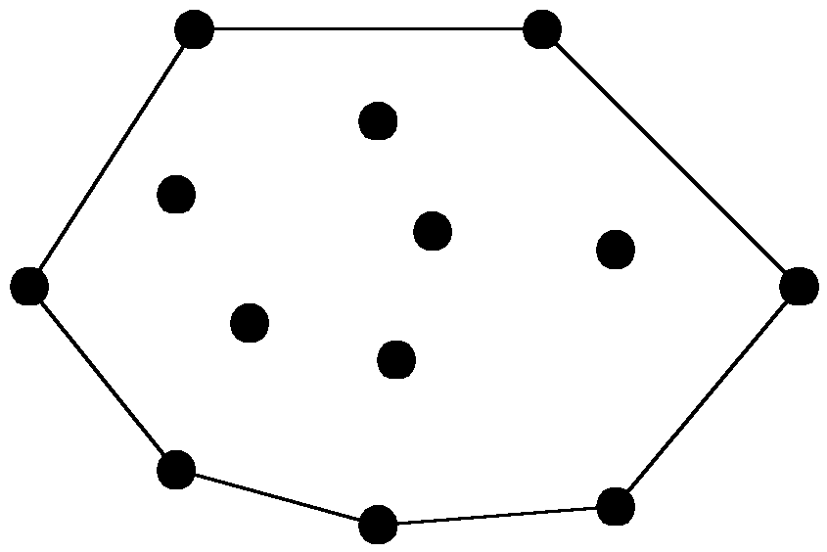
Convex Hull
Definition:
Informal: Convex hull of a set of points in plane is the shape taken by a rubber band stretched around the nails pounded into the plane at each point.
Formal: The convex hull of a set of planar points is the smallest convex polygon containing all of the points.

Slide 6
Graham Scan
Concept:
Start at point guaranteed to be on the hull. (the point with the minimum y value)
Sort remaining points by polar angles of vertices relative to the first point.
Go through sorted points, keeping vertices of points that have left turns and dropping points that have right turns.

Slide 7
Graham Scan - Example
p₁₀
p₉
p₆
p₁₂
p₇
p₅
p₄
p₃
p₁₁
p₈
p₁
p₂
p₀

Slide 8
Graham Scan - Example
p₁₀
p₉
p₆
p₁₂
p₇
p₅
p₄
p₃
p₁₁
p₈
p₁
p₂
p₀

Slide 9
Graham Scan - Example
p₁₀
p₉
p₆
p₁₂
p₇
p₅
p₄
p₃
p₁₁
p₈
p₁
p₂
p₀

Slide 10
Graham Scan - Example
p₁₀
p₉
p₆
p₁₂
p₇
p₅
p₄
p₃
p₁₁
p₈
p₁
p₂
p₀

Slide 11
Graham Scan - Example
p₁₀
p₉
p₆
p₁₂
p₇
p₅
p₄
p₃
p₁₁
p₈
p₁
p₂
p₀

Slide 12
Graham Scan - Example
p₁₀
p₉
p₆
p₁₂
p₇
p₅
p₄
p₃
p₁₁
p₈
p₁
p₂
p₀

Slide 13
Graham Scan - Example
p₁₀
p₉
p₆
p₁₂
p₇
p₅
p₄
p₃
p₁₁
p₈
p₁
p₂
p₀

Slide 14
Graham Scan - Example
p₁₀
p₉
p₆
p₁₂
p₇
p₅
p₄
p₃
p₁₁
p₈
p₁
p₂
p₀

Slide 15
Graham Scan - Example
p₁₀
p₉
p₆
p₁₂
p₇
p₅
p₄
p₃
p₁₁
p₈
p₁
p₂
p₀

Slide 16
Graham Scan - Example
p₁₀
p₉
p₆
p₁₂
p₇
p₅
p₄
p₃
p₁₁
p₈
p₁
p₂
p₀

Slide 17
Graham Scan - Example
p₁₀
p₉
p₆
p₁₂
p₇
p₅
p₄
p₃
p₁₁
p₈
p₁
p₂
p₀

Slide 18
Graham Scan - Example
p₁₀
p₉
p₆
p₁₂
p₇
p₅
p₄
p₃
p₁₁
p₈
p₁
p₂
p₀

Slide 19
Graham Scan - Example
p₁₀
p₉
p₆
p₁₂
p₇
p₅
p₄
p₃
p₁₁
p₈
p₁
p₂
p₀

Slide 20
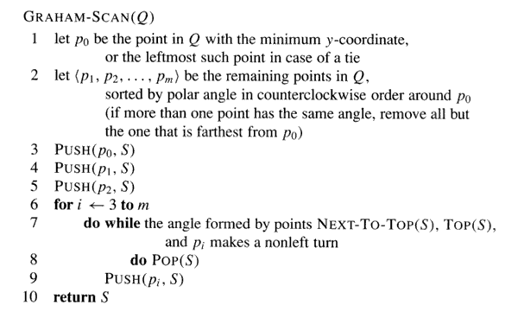
Graham Scan - Algorithm

Slide 21
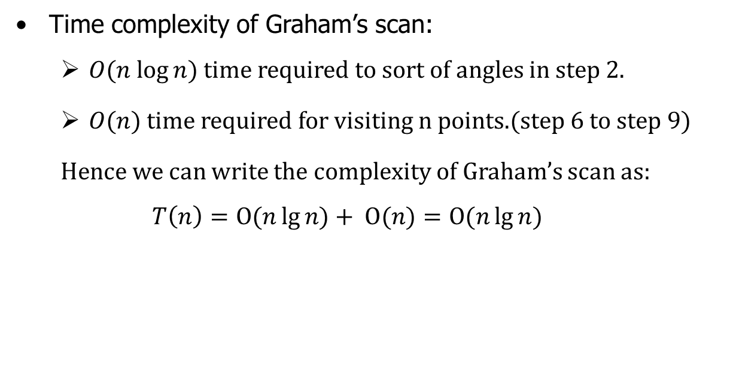
Graham Scan - Algorithm
Time complexity of Graham’s scan:
$O(n log⁡n)$time required to sort of angles in step 2.
$O(n)$ time required for visiting n points.(step 6 to step 9)
Hence we can write the complexity of Graham’s scan as:
$$T\left(n\right)=Ο(n\lg{n)+ Ο(n)}=Ο(n\lg{n)}$$

Slide 22
Divide and Conquer (Quickhull)
QuickHull uses a Divide and Conquer approach similar to the Quick Sort algorithm.
Benchmarks showed it is quite fast in most average cases.
Recursive nature allows a fast and yet clean implementation.

Slide 23
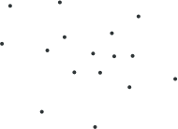
Divide and Conquer (Quickhull)
Initial Input
The initial input to the algorithm is an arbitrary set of points as shown in the figure.

Slide 24
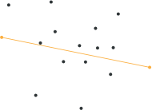
Divide and Conquer (Quickhull)
First Two Points on the Convex Hull
Starting with the given set of points the first operation done is the calculation of the two maximal points on the horizontal axis. i.e.

Slide 25
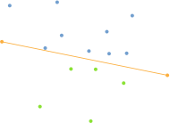
Divide and Conquer (Quickhull)
Recursively Divide
Next the line formed by these two points is used to divide the set into two different parts.
Everything left from this line is considered one part, everything right of it is considered another one.
Both of these parts are processed recursively.

Slide 26
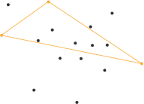
Divide and Conquer (Quickhull)
Max Distance Search
To determine the next point on the convex hull a search for the point with the greatest distance from the dividing line is done.
This point, together with the line start and end point forms a triangle.

Slide 27
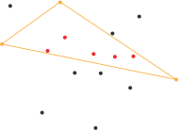
Divide and Conquer (Quickhull)
Point Exclusion
All points inside this triangle can not be part of the convex hull polygon, as they are obviously lying in the convex hull of the three selected points.
Therefore these points can be ignored for every further processing step.

Slide 28
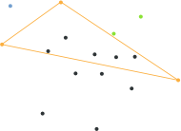
Divide and Conquer (Quickhull)
Recursively Divide
Having this in mind the recursive processing can take place again.
Everything right of the triangle is used as one subset, everything left of it as another one.

Slide 29
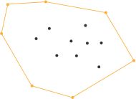
Divide and Conquer (Quickhull)
Abort Condition
At some point the recursively processed point subset does only contain the start and end point of the dividing line.
If this is case this line has to be a segment of the searched hull polygon and the recursion can come to an end.

Slide 30
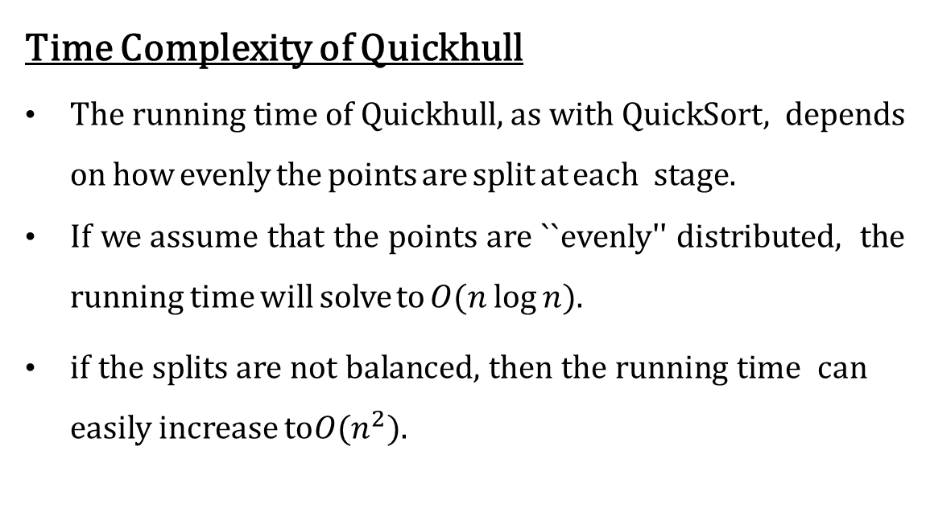
Divide and Conquer (Quickhull)
Time Complexity of Quickhull
The running time of Quickhull, as with QuickSort, depends on how evenly the points are split at each stage.
If we assume that the points are ``evenly'' distributed, the running time will solve to $O(n log⁡n).$
if the splits are not balanced, then the running time can easily increase to $O(n^{2}).$

Slide 31

Thank U

